Slide 1


Design of Metamaterial/metasurface based on efficient antenna for RF energy harvesting and wireless energy transmission
Mid-Review 1/2/3
Major Project
Project ID: c1
AY 2021-25
GITAM (Deemed-to-be) University
Project Team:
P.A.SRUTHI (BU21EECE0100468)
D.ASHABEE (BU21EECE0100143)
G.DHATHRI (BU21EECE0100201)
Department of Electrical Electronics and Communication Engineering
Project Mentor:
Dr. Akhilendra Pratap Singh
www.gitam.edu

Slide 2
Objective and Goals
Objective
To design and optimize microstrip patch antennas using HFSS for RF energy harvesting and wireless power transmission in the 1 to 5 GHz frequency range, focusing on improving gain, radiation pattern, dielectric properties, and frequency performance. The research aims to develop an efficient antenna system that maximizes energy capture and transmission under ambient conditions.
Goals
Main Goals
Enhancing Antenna Gain
Improving Radiation Pattern
Maximizing Frequency Performance
Optimizing Dielectric Properties

Slide 3
Project Plan (Clearly mention milestone for objectives under each reviews)
Review 1: Literature Review and Initial Design
Conduct a literature review on metasurface/metamaterial antennas.
Define design specifications for dual-frequency operation (2.45 GHz to 5GHz).
Develop the initial antenna design with metasurface/metamaterial integration.
Review 2: Simulation and Optimization
Perform HFSS simulations to analyze:
Impedance matching.
Bandwidth and radiation characteristics.
Optimize the design for efficient energy harvesting and wireless energy transmission.
Review 3: Validation and Finalization
Validate the antenna's performance at 2.45 GHz to 5GHz
Refine the design based on validation results.
Prepare the final project report and presentation.

Slide 4
Literature Survey (Improved post minor project)
s:no | TITTLE | AUTHOR | YEAR OF PUBLISHING | DRAW BACKS
1 | Design of RF energy harvesting Antenna using optimization techniques | Vijay Gokul(MCE, Madurai),M. Suba Lakshmi,TSweta | April 2020 | Limited Frequencies Reliance on Simulations Complicated Methods Lack of Practical Use
2 | Design and implementation of microstrip patch antenna | John Colaco,Rajesh Lohani | 2020 | 5g application Bandwidth limitation radiation pattern gain and efficiency
3 | Circularly polarized microstrip patch antenna with tilted patch and DGS for ambient RF energy harvesting | Parul Saini,Shivani Malhotra,Lipika Gupta | 2024 | Limited Frequency Range Reliance on Simulations Complex Design Environmental Impact Not Addressed

Slide 5
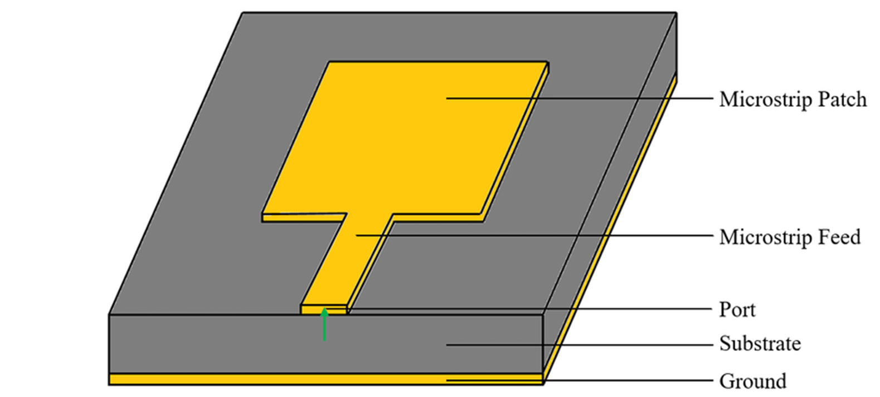
Architecture

Slide 6
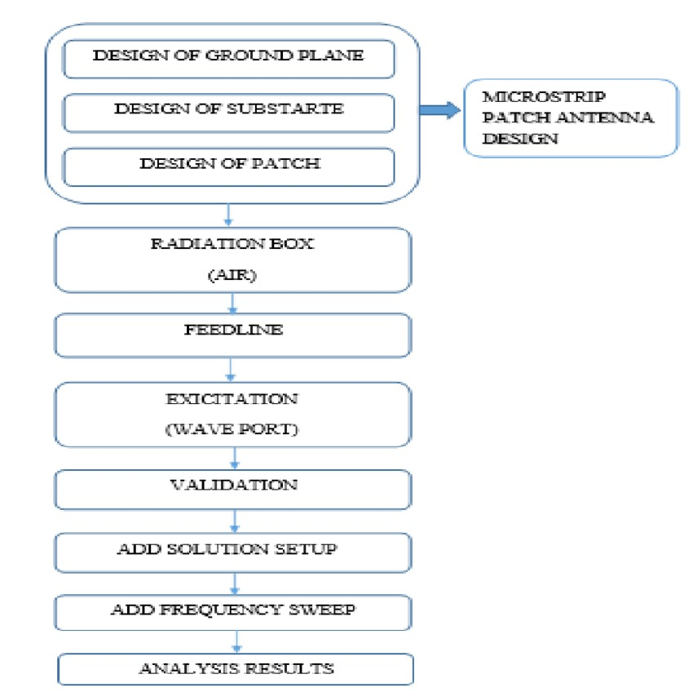

Slide 7
Use Cases & Testing
USE CASES
Wireless Sensor Networks (WSNs)
Use Case: Sensors in remote or hard-to-reach places (e.g., agriculture or industrial monitoring) can use RF energy from nearby signals (like Wi-Fi) to power themselves.
Benefit: Reduces the need for batteries and manual maintenance.
IoT Devices
Use Case: Devices like smart home sensors can collect power from RF signals, extending their battery life or eliminating the need for charging.
Benefit: Makes IoT devices more reliable and energy-efficient.
Wearable Electronics
Use Case: Fitness trackers and medical wearables can harvest energy from surrounding RF signals, reducing the need for frequent charging.
Benefit: Increases convenience and usability for users.
Smart Agriculture
Use Case: Sensors in fields can be powered by RF signals to monitor soil and crops without needing battery replacements.
Benefit: Saves time and cost for farmers by reducing manual maintenance.
Medical Implants
Use Case: Devices like pacemakers can be powered by RF energy, reducing the need for surgeries to replace batteries.
Benefit: Improves patient safety and comfort.
Asset Tracking
Use Case: RFID tags or tracking devices on shipping containers can use RF energy to report their location without requiring batteries.
Benefit: Allows real-time tracking without frequent battery changes.

Slide 8
TEST CASES
Test Case: Impedance Matching
Objective: Ensure the antenna is well-tuned to collect RF energy efficiently.
Test: Adjust the antenna size to match the energy collection circuit. Check the reflection (S11) to see if it’s below -10 dB.
Expected Result: The antenna should collect energy effectively at the chosen frequency, with low reflection.
Test Case: Antenna Radiation Pattern
Objective: Test how the antenna radiates or collects energy from different directions.
Test: Simulate the radiation pattern of the antenna in HFSS.
Expected Result: The antenna should direct most of the energy toward the desired direction for better performance.
Test Case: Antenna Gain
Objective: Verify the antenna’s ability to focus energy in a specific direction (directional gain).
Test: Simulate the antenna's far-field radiation pattern in HFSS and calculate the gain (in dBi).
Expected Result: The antenna should have a gain of 5–10 dBi or higher in the main direction to ensure efficient energy harvesting in that direction.
Test Case: Gain vs Frequency
Objective: Test how the antenna gain varies over different frequencies.
Test: Simulate the gain across a range of frequencies (e.g., 900 MHz to 2.4 GHz).
Expected Result: The antenna should maintain relatively high gain across the desired frequency range, with minimal loss in performance.

Slide 9
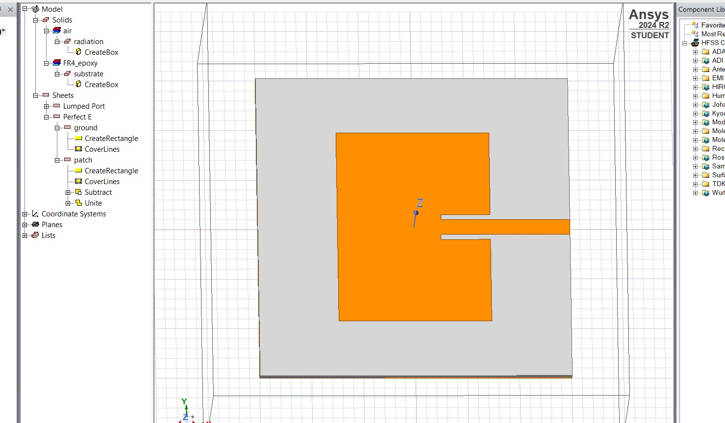
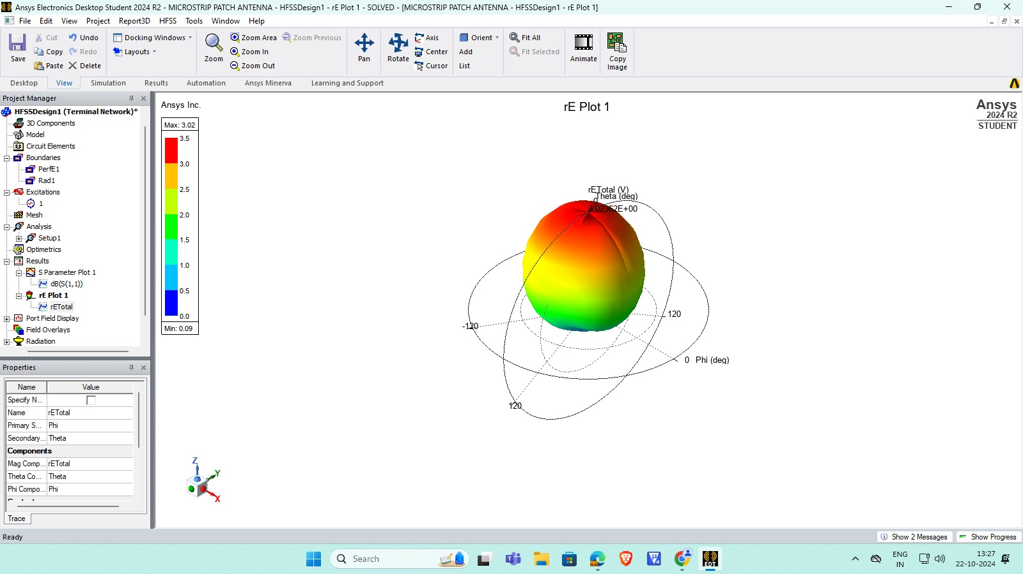
Implementation and Results – Iteration 1
Iteration 1 : Results

Slide 10
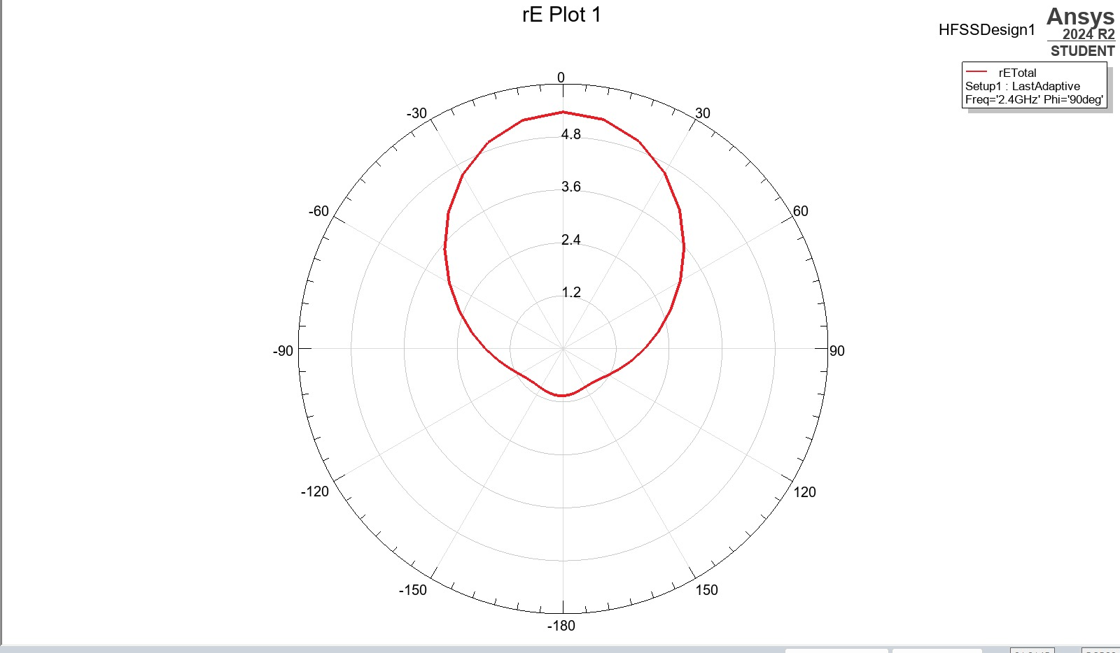
Implementation and Results – Iteration 2

Slide 11
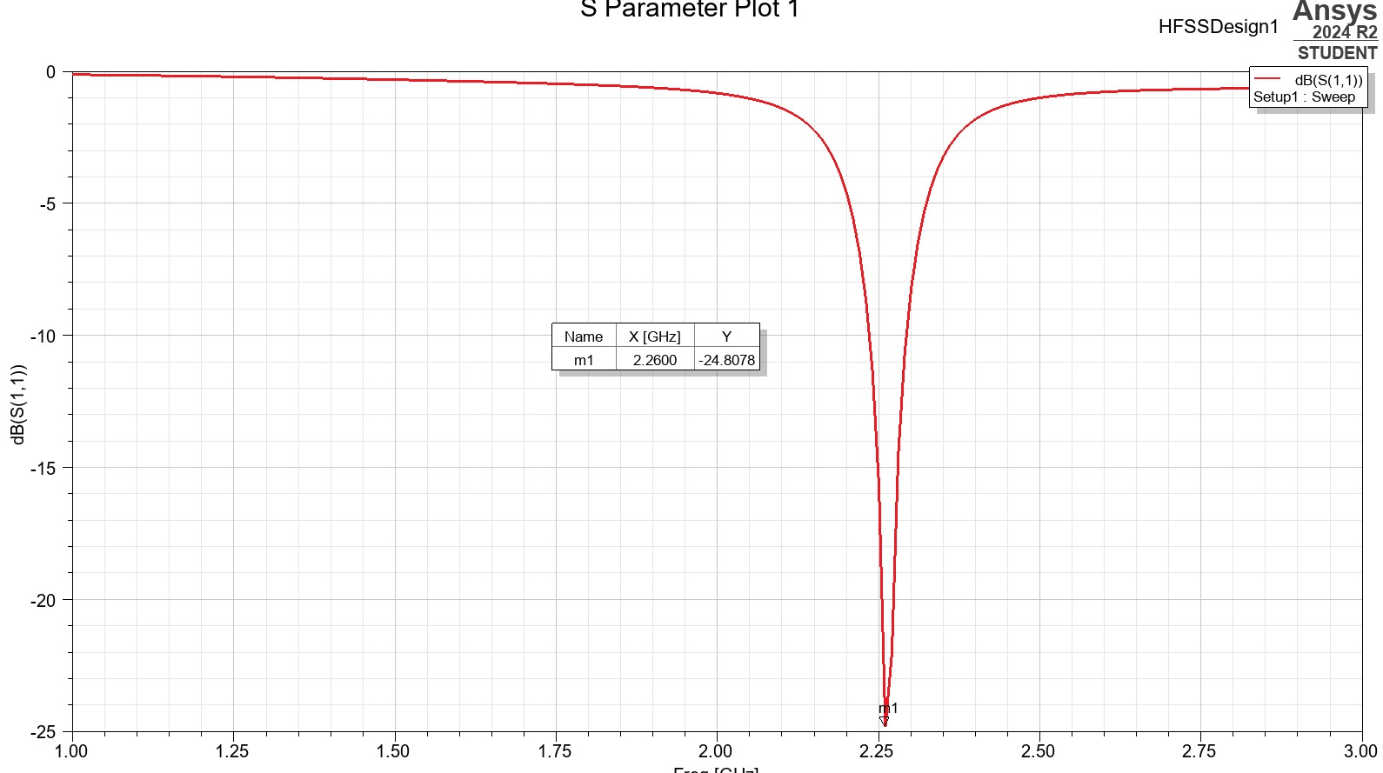

Slide 12
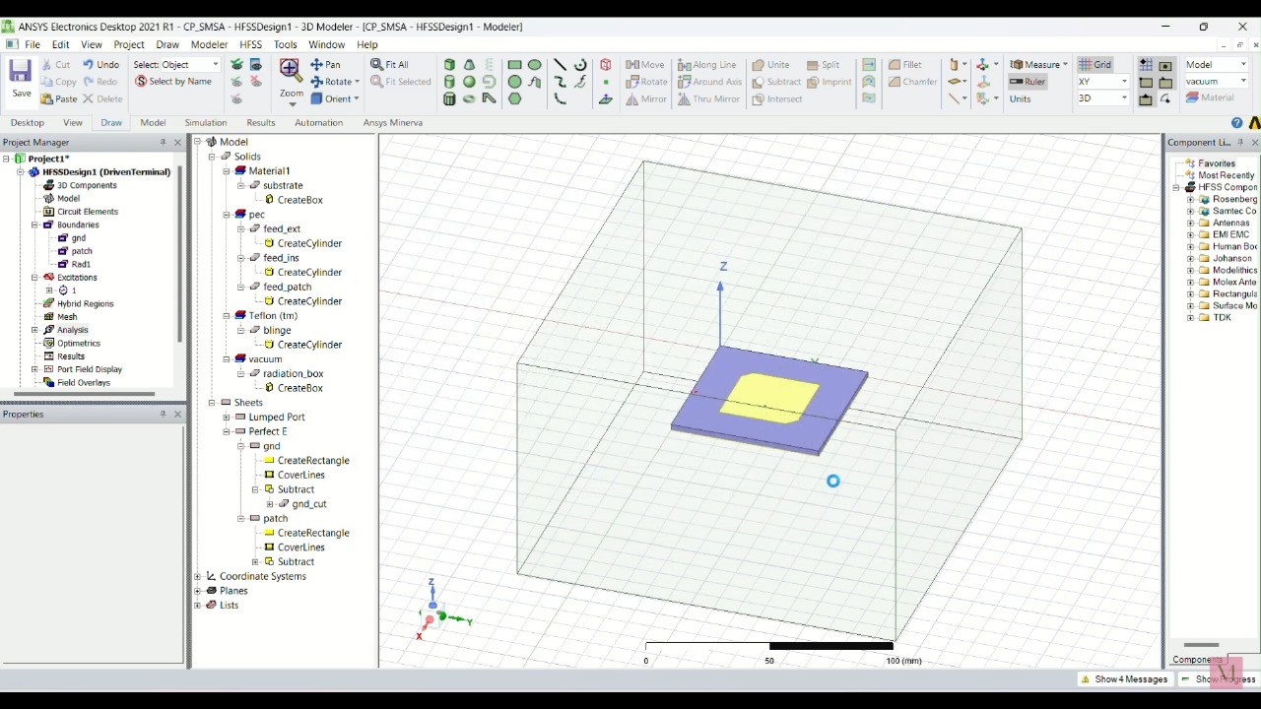

Slide 13
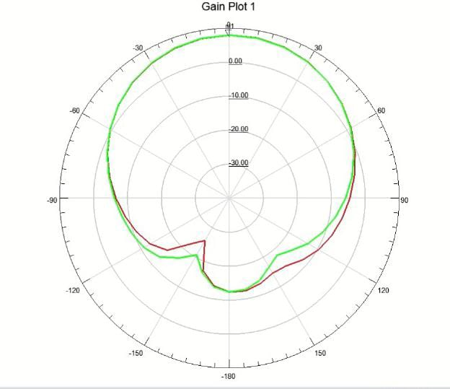
Implementation and Results – Iteration 3 (Optional)

Slide 14
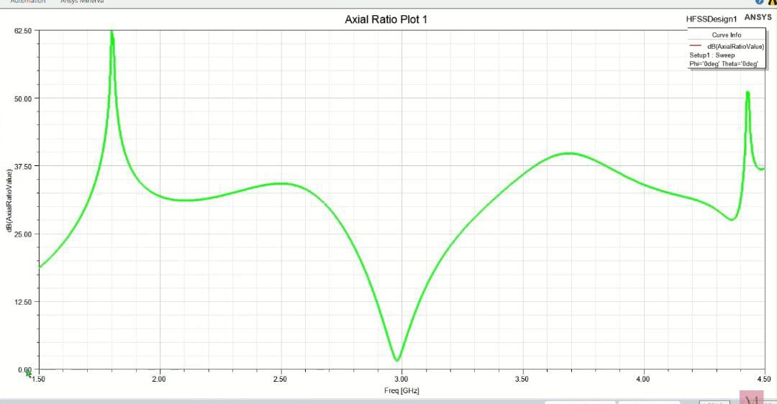
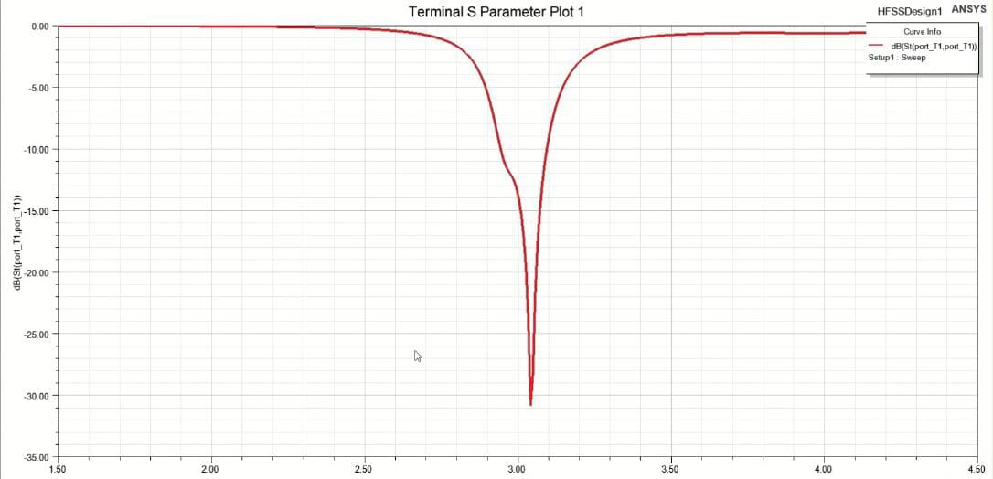

Slide 15
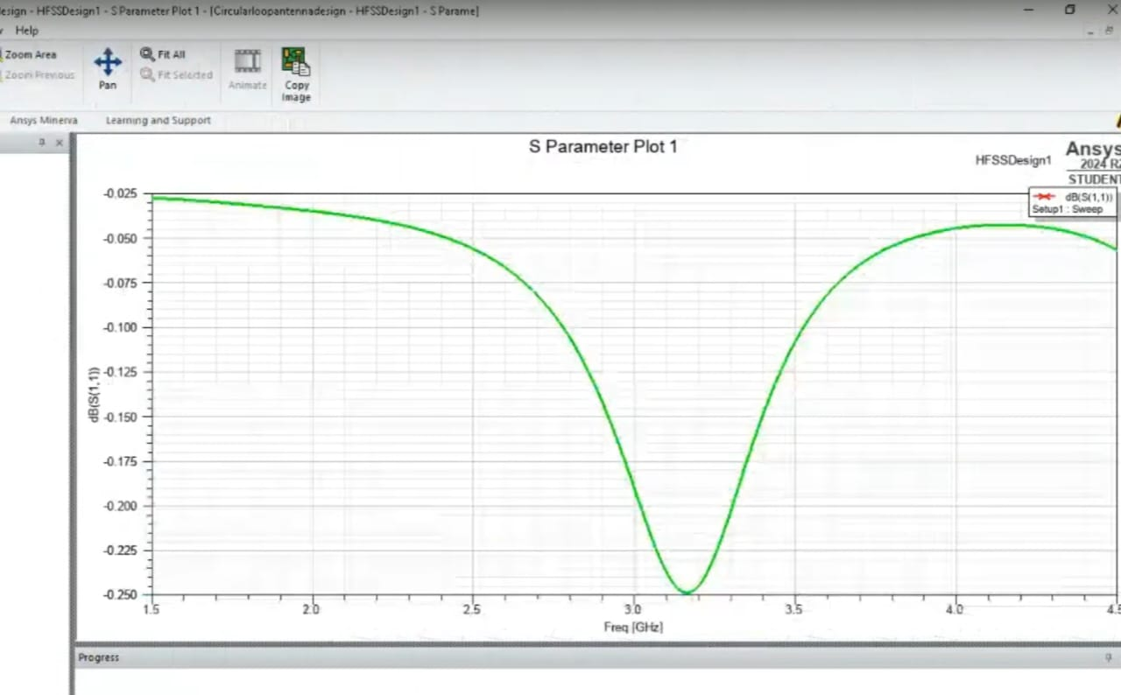
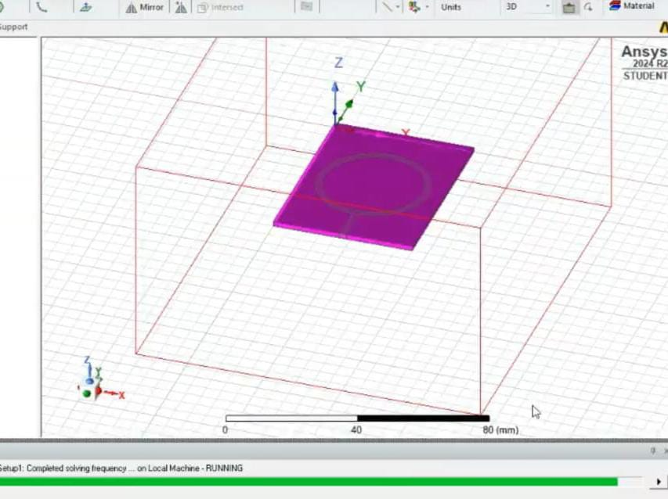
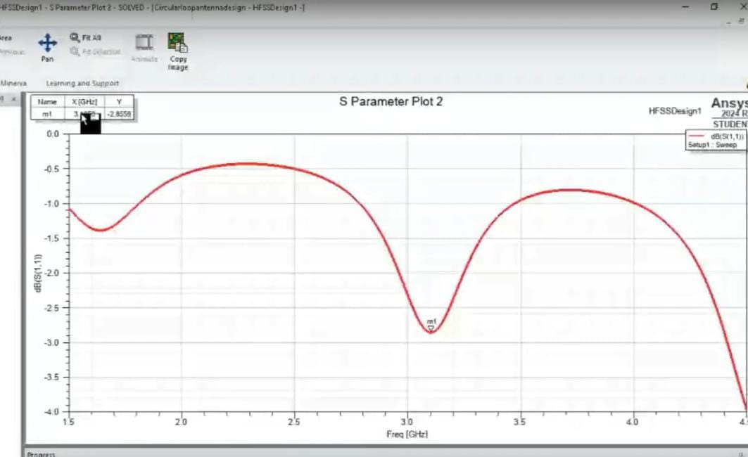
CIRCULAR LOOP ANTEENA:

Slide 16
Contribution
Team Progress and Movement
Our team has made significant progress, though the project is still ongoing:
Antenna Design and Simulation: We have completed the initial design and simulation of the rectangular patch antenna (2.45 GHz) using HFSS software. Work on the circular patch antenna (3 GHz) is still in progress.
Research and References: Team members have gathered several key research papers that are helping us refine our designs and improve antenna performance.
Resource Management: We have successfully obtained the necessary tools and software to carry out the simulations. Additional materials are being sourced for the next phase of the project.
Presentation and Report Preparation: Preliminary work on the final report and presentation has begun, but these deliverables will be finalized once the antenna simulations are completed.
While we've achieved several key milestones, more work is needed to complete the remaining tasks.

Slide 17
Individual Contribution
Key contributions: P.A.SRUTHI
Completed the design and simulation of the rectangular patch antenna at 2.45 GHz and the circular patch antenna at 3 GHz using HFSS software
collected the reference papers for the further designing of antenna
Key contributions: D.ASHA BEE
collected the reference paperes for the further designing of antenna
helped for the resourses providing for the project
Designed the circular patch antenna at 3 GHz using HFSS software
Key contribution: G.DHATHRI
Designed the circular patch antenna at 3 GHz using HFSS software
collected reference papers for the antenna designing

Slide 18
Conclusion & Future Work
Summary and Conclusion:
Our project focused on the design and simulation of efficient antennas for RF energy harvesting and wireless energy transmission using metamaterials and meta surfaces. We successfully designed and simulated a rectangular patch antenna operating at 2.45 GHz and are in progress with the circular patch antenna at 3 GHz using HFSS software. Throughout the project, we gathered key reference papers, optimized the design process, and ensured that the necessary tools and resources were available to meet our objectives.
Future Work:
While the project is still in progress, the initial results from the rectangular patch antenna simulation are promising. Once the design and simulation of the circular patch antenna are completed, we anticipate further improvements in performance. The combination of metamaterials and optimized antenna design holds great potential for enhancing RF energy harvesting. This project sets the foundation for future research in efficient wireless energy transmission, which could have significant implications for sustainable energy technologies and advancing wireless communication systems.

Slide 19
THANK YOU
Have a Great Day !

